Slide 1

Beyond MOOCs: Open Education at Scale
Charles Severance
University of Michigan School of Information
Sakai PMC Chair
www.py4e.com

Slide 2
MOOC/EdTech Experience
I was a founder of the Sakai Open Source LMS project in 2004
I was one of the core Contributors to IMS Learning Tools Interoperability in 2010
Michigan is one of the four founding Schools of Coursera in 2012
I taught one of the first six Michigan courses on Coursera
Internet History, Technology, and Security
I now teach six MOOCs on Coursera
Python for Everybody Specialization (5 courses)

Slide 3
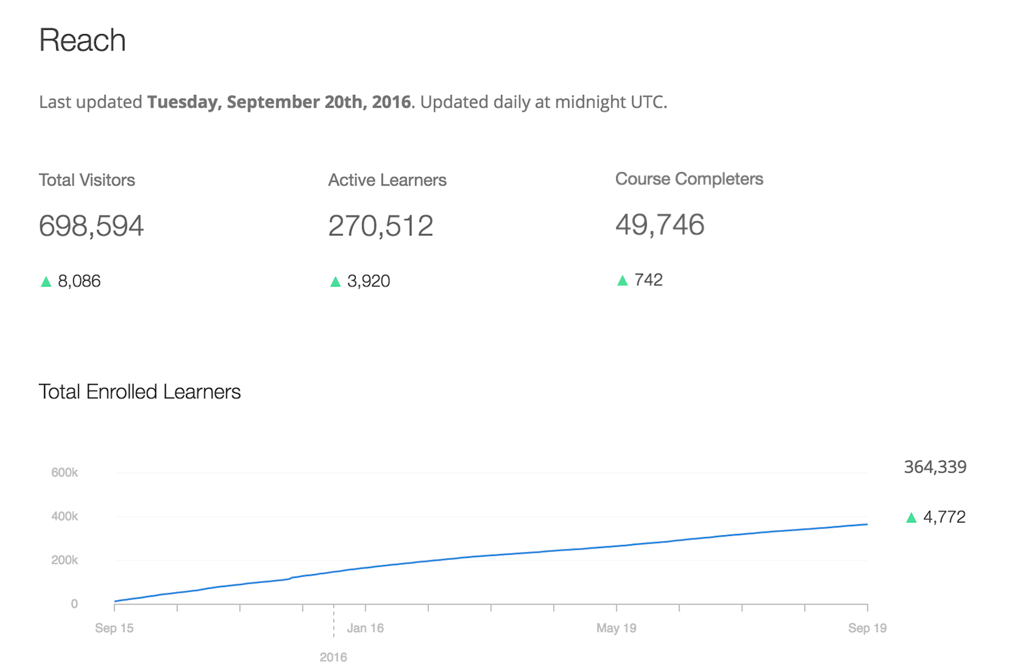

Slide 4

Beyond the LMS Beyond the MOOC
What is next?

Slide 5
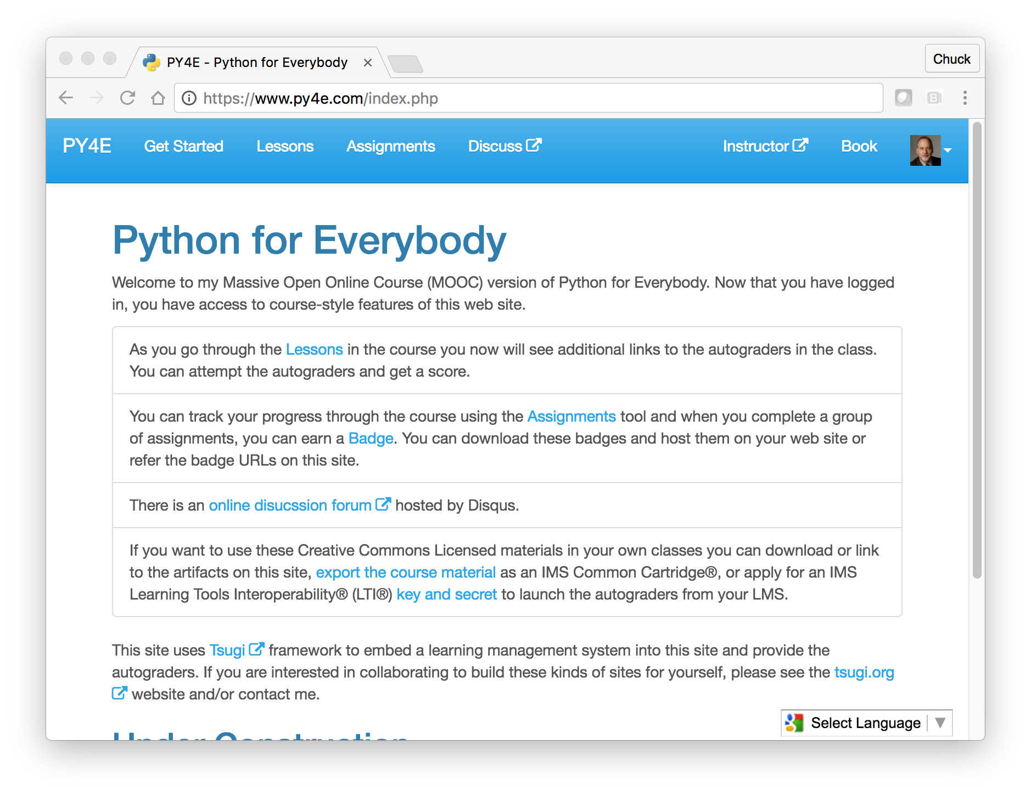
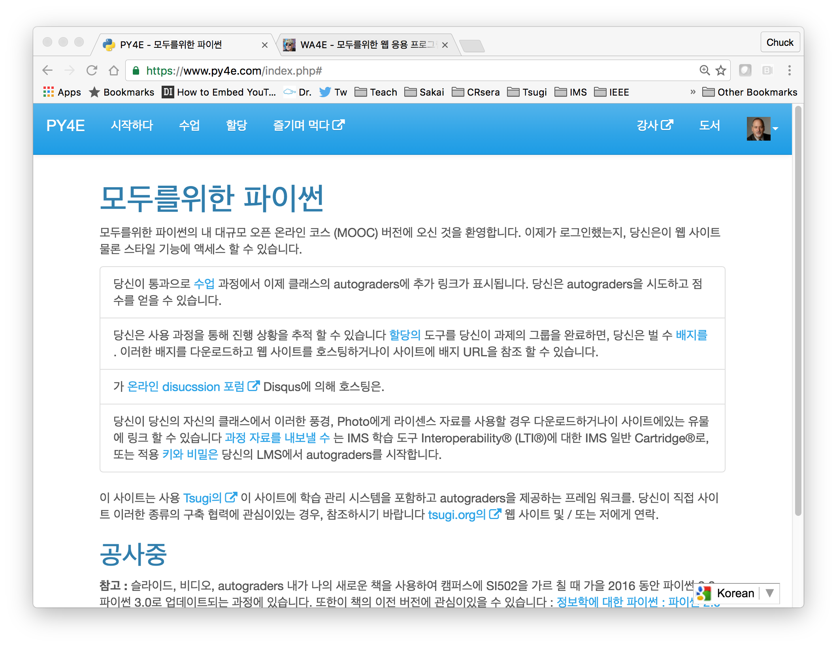
www.py4e.com

Slide 6

http://planet-fall.deviantart.com/art/The-Monolith-80407794

Slide 7
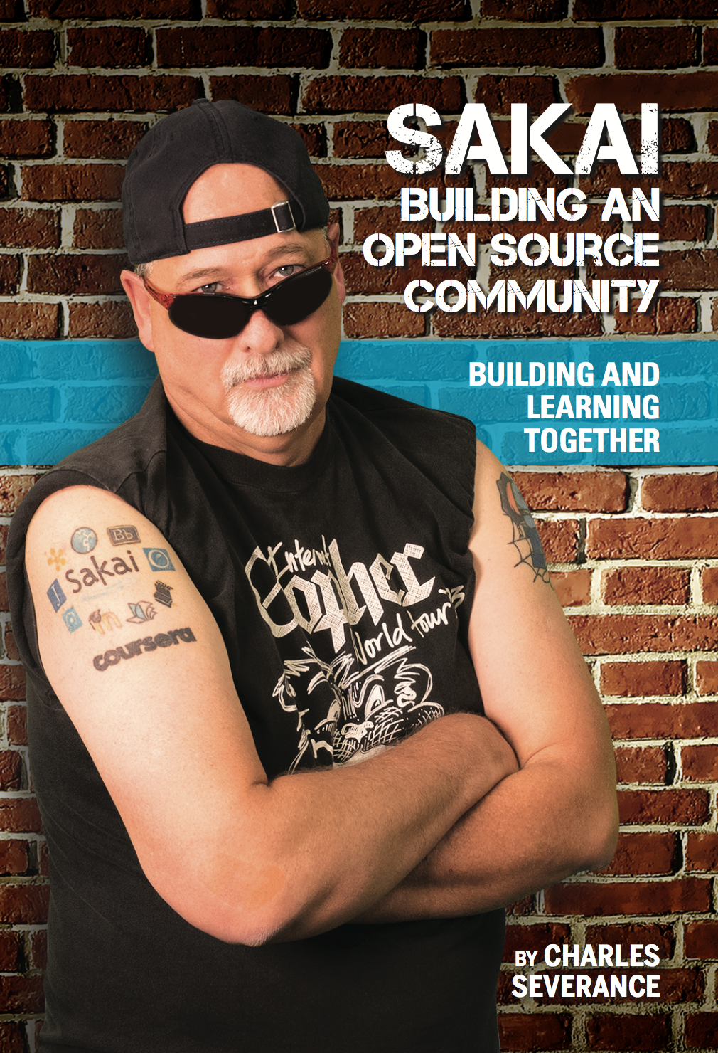
Enterprise Learning Management System (LMS) Been there – done that – got the tattoo.. But…

Slide 8
Enterprise Solutions
Campus-wide Learning Management Systems
Sakai, Canvas, Moodle, Blackboard, Desire2Learn… 100s more
Learning Object Repositories
Canvas Commons, Blackboard xpLor, MERLOT
Massive Publishers
Pearson, McGraw-Hill, K12.com
MIT Open Courseware, etc
Coursera, Udacity, Lynda, Udemy, edX

Slide 9
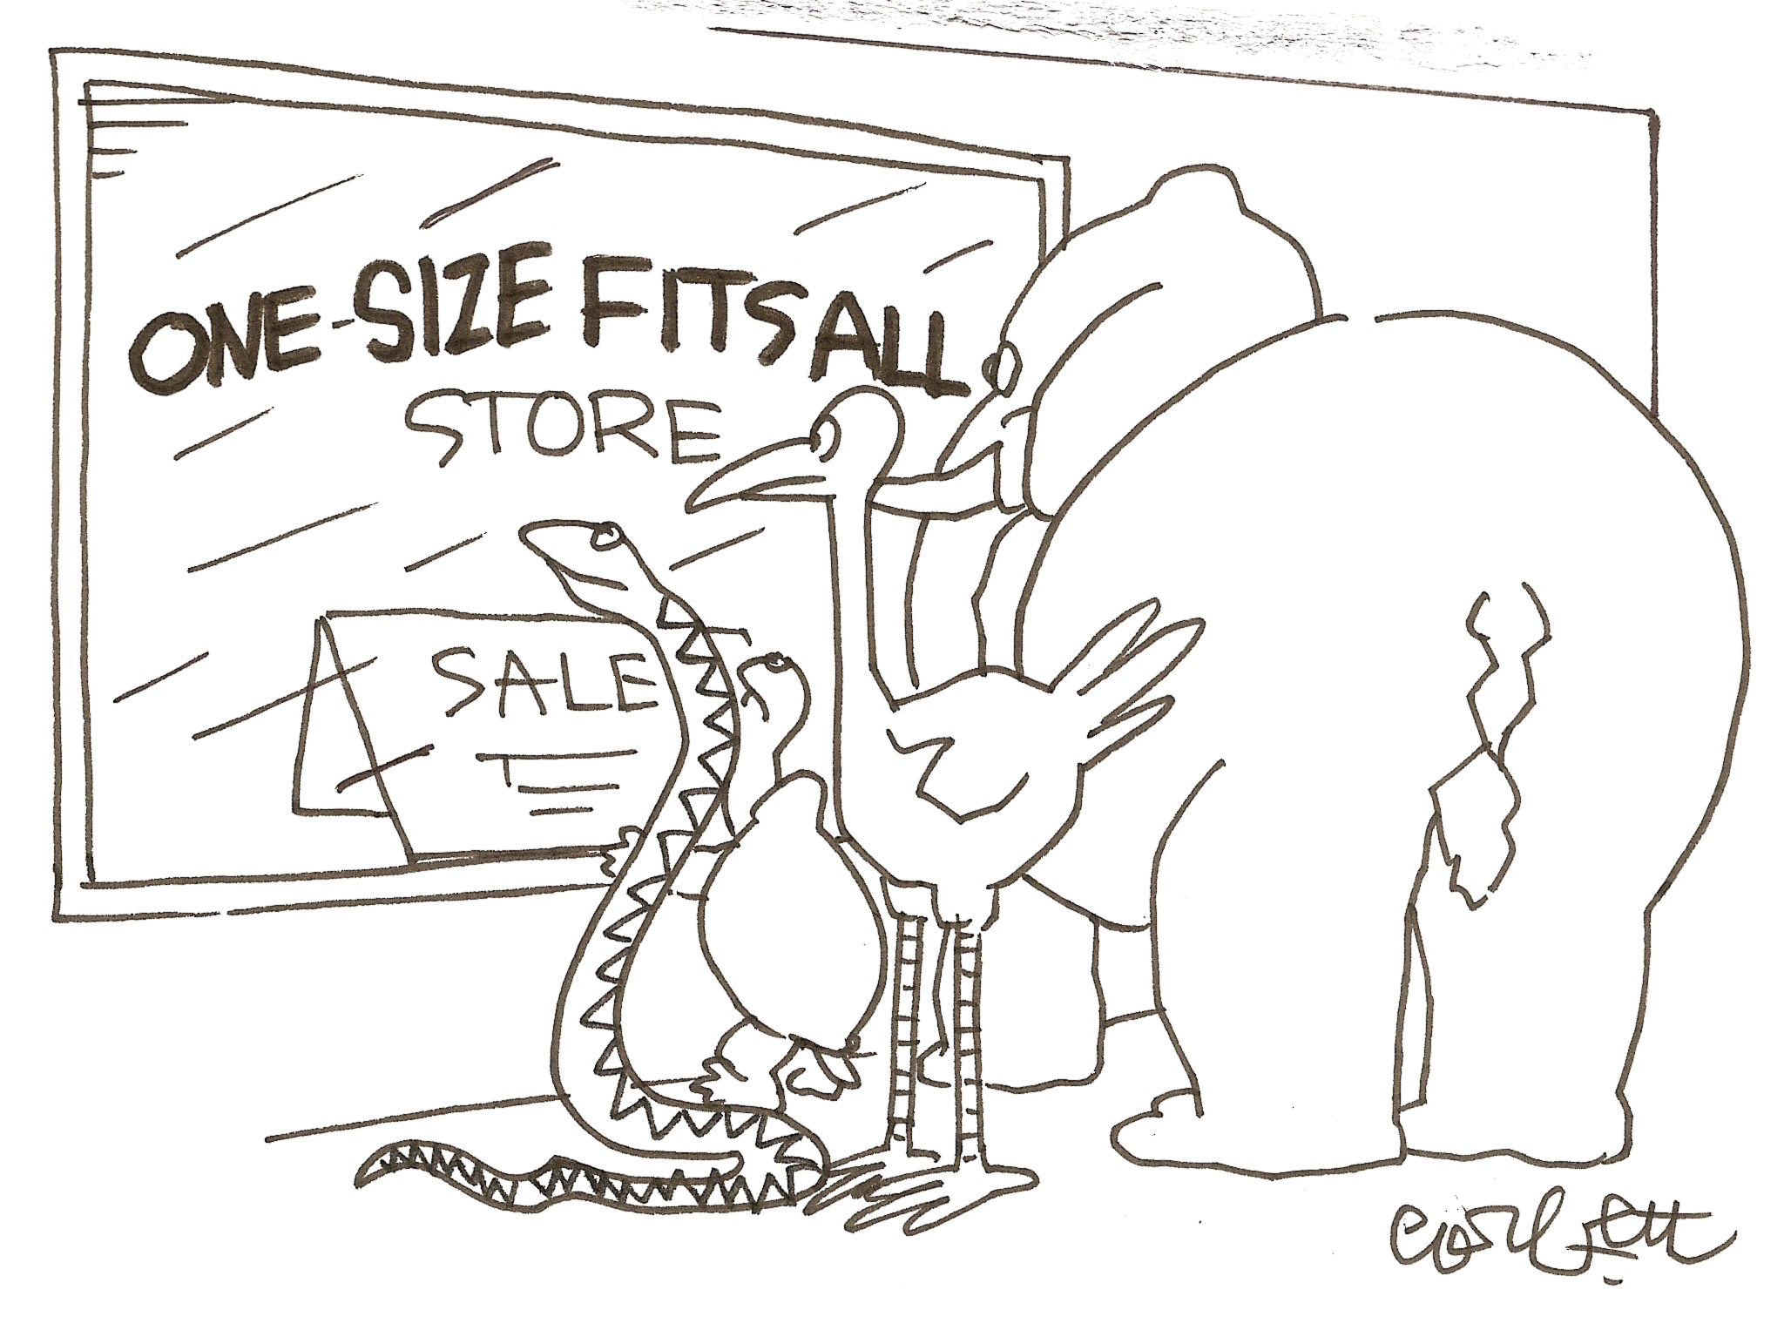

Slide 10

Distinct, unique and yet similar

Slide 11
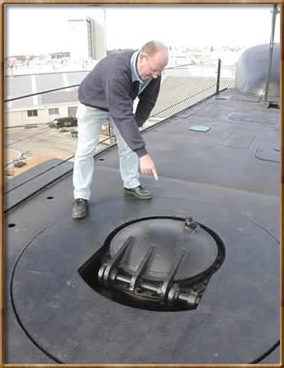

Standards (Classic)
IMS Learning Tools Interoperability (LTI) 1.0
17 May 2010
IMS Common Cartridge(CC) 1.0
1 October 2008

Slide 12
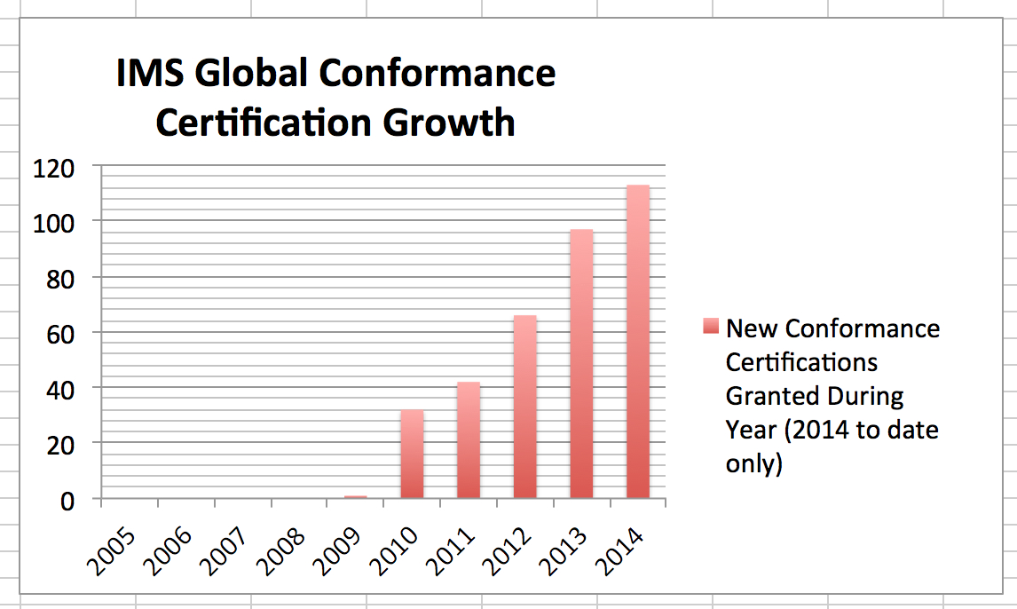
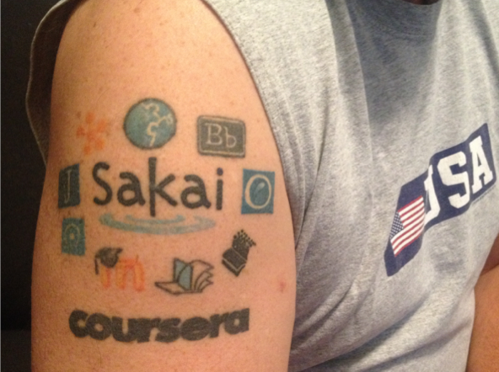

Slide 13
Single-Vendor "Ecosystems"
Repositories
Blackboard xpLor
Canvas Commons
App Store:
Canvas EduAppCenter
Small LMS + App Store + Marketed to Teacher
Edmodo – App Store not LTI
Schoology – App Store with LTI

Slide 14
Expanding Standards
IMS Common Cartridge – 1.0, 1.1, 1.2, 1.3
IMS Learning Tools Interoperability 1.0, 1.1, 2.0, 2.1
IMS LTI Content Item - 1.0
IMS LTI Membership Service – 1.0
IMS LTI Outcomes 1.0, 2.0
IMS Caliper - 1.0
IMS OneRoster – 1.1
IMS CASA App Store – Relaunching
IMS CC / EPUB 3.0 Coordination

Slide 15



Open Educational Resources
Expanding
Standards
MOOCs
Next Generation Digital Learning Environment

Slide 16
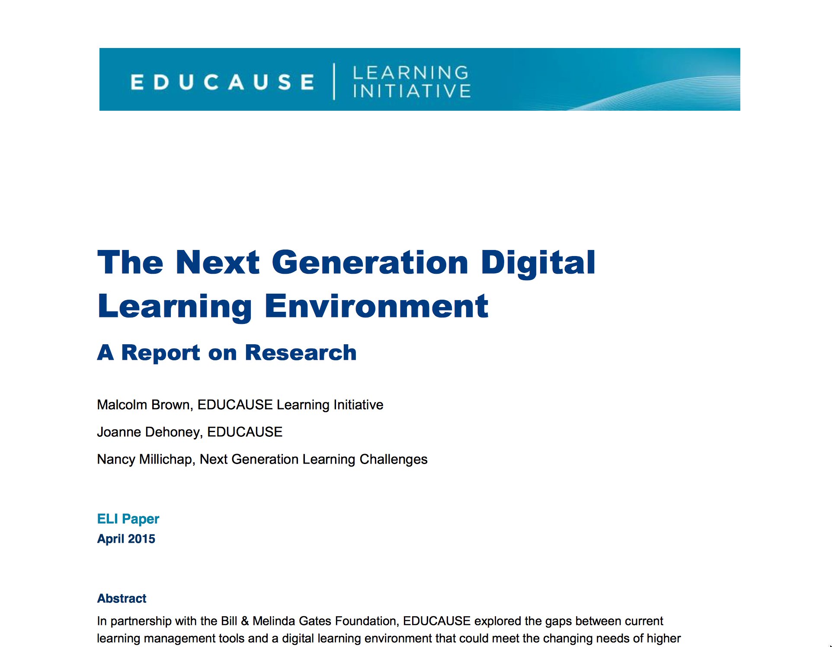
https://net.educause.edu/ir/library/pdf/eli3035.pdf

Slide 17
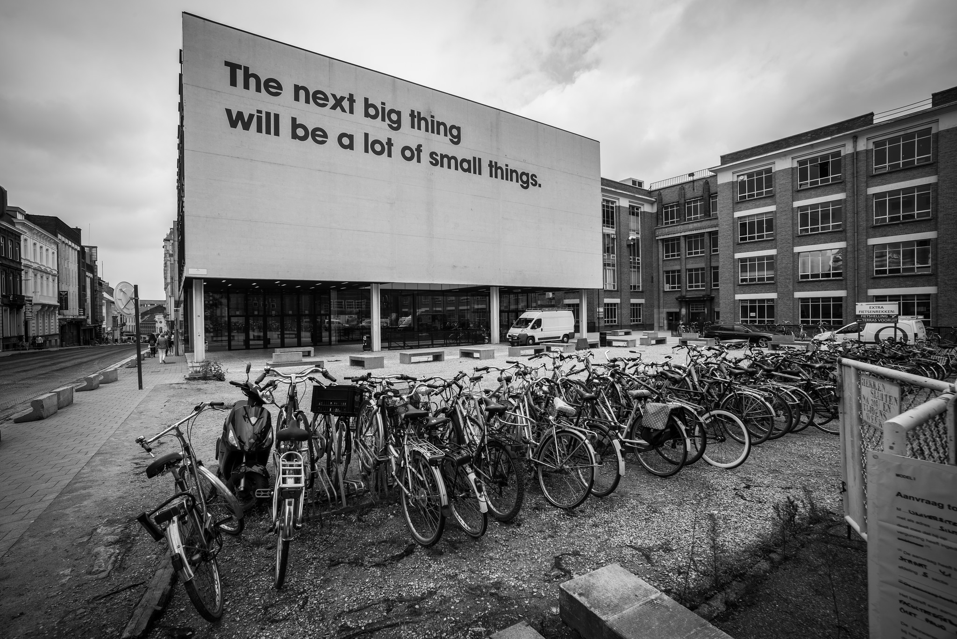
Source: Ian Dolphin

Slide 18
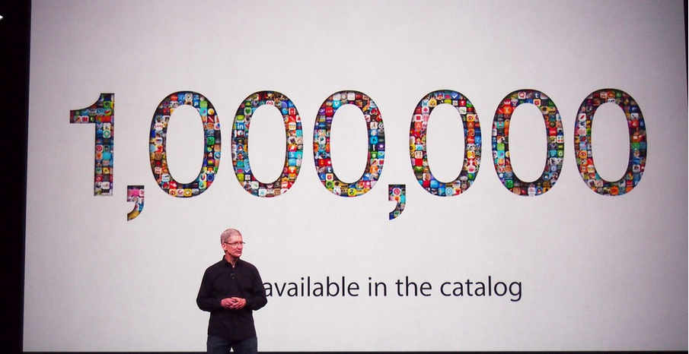
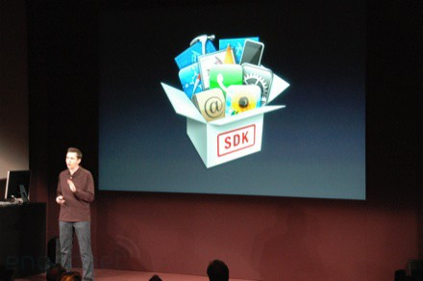
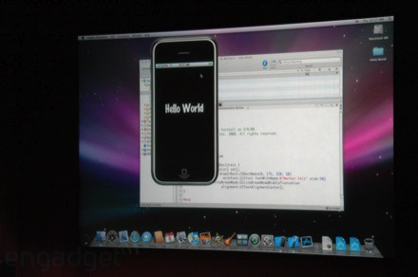
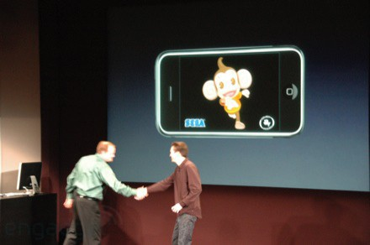
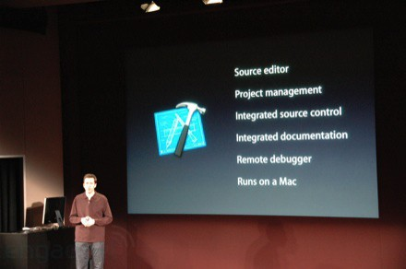
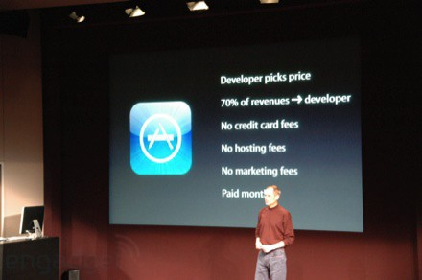
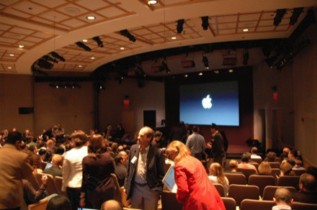
March 6, 2008 iPhone SDK Press Conference

Slide 19
http://planet-fall.deviantart.com/art/The-Monolith-80407794
https://pixabay.com/static/uploads/photo/2014/12/02/22/05/snowflake-554635_960_720.jpg

Slide 20
Easy or Not?
Need to develop standards for interoperability
Need to train 1000's of developers to implement the standards
As standards improve they expand and get more complex

Slide 21
Easy or Not?
Need to develop standards for interoperability
Need to train 1000's of developers to implement the standards
As standards improve they expand and get more complex
Perhaps we can never get to a million learning tools or learning objects
Why even try?

Slide 22
We need a "WordPress"
A free downloadable off-the-shelf software package that gets people building tools and content and in production in < 4 hours
Allow thousands of educational sites to be built and put into production by anyone

Slide 23
"EduPress"
An Learning Management System (LMS) of my own
An Open Educational Resource site of my own
A Learning Object Repository (LOR) of my own
A Learning Record Store (LRS) of my own
Millions of sites – millions of courses all similar with a common structure but all unique and distinct

Slide 24
What is Tsugi?
Software to allow anyone to build and deploy interoperable educational web sites, content, and learning tools

Slide 25

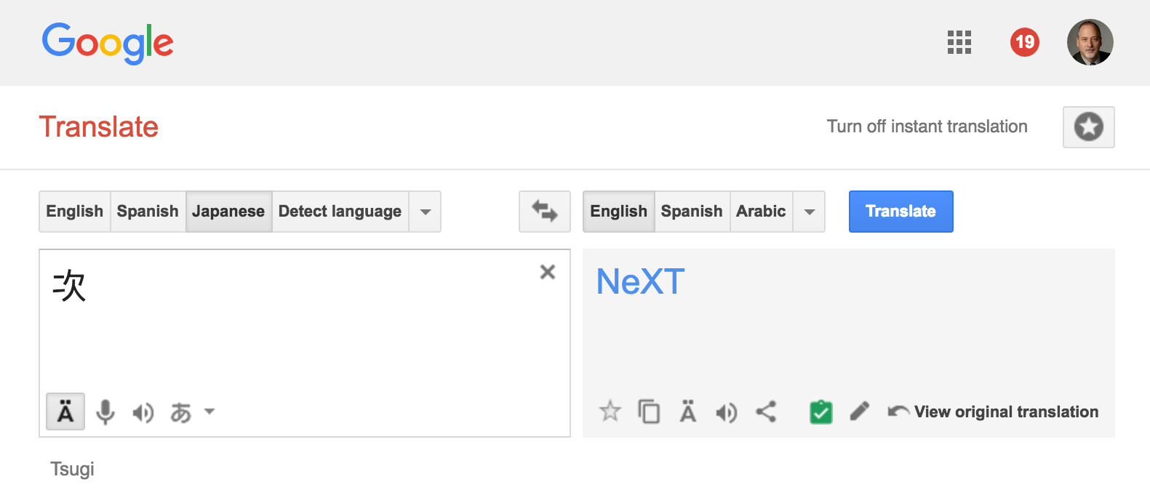
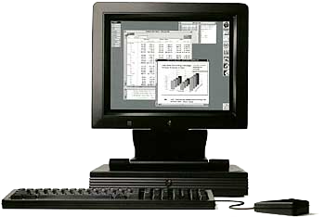
What is in a name?

Slide 26

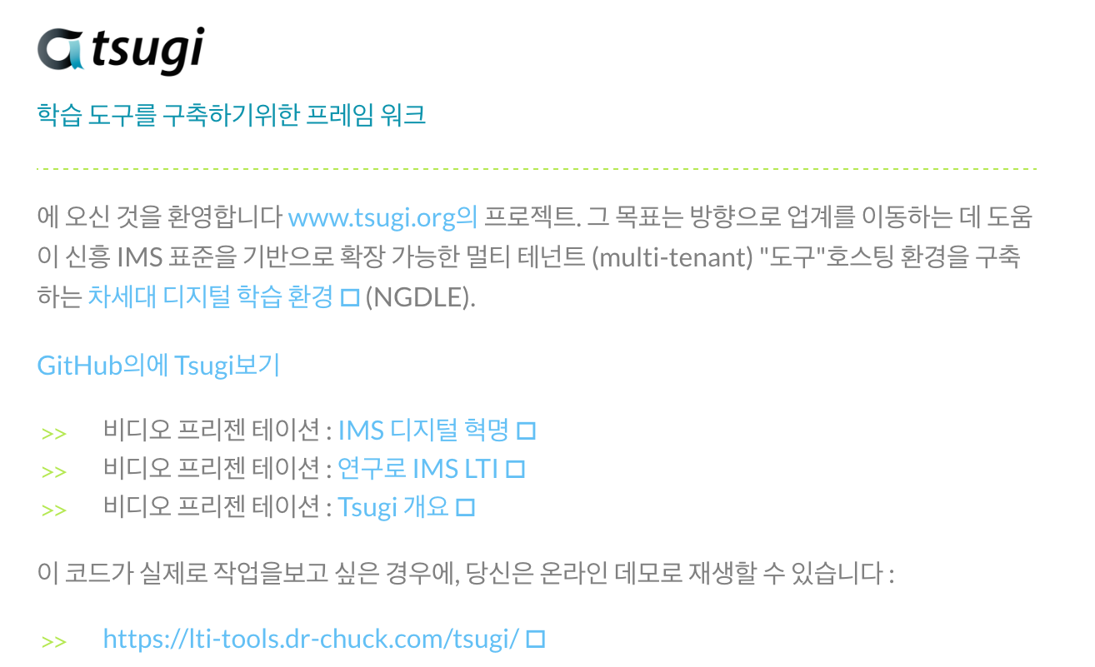
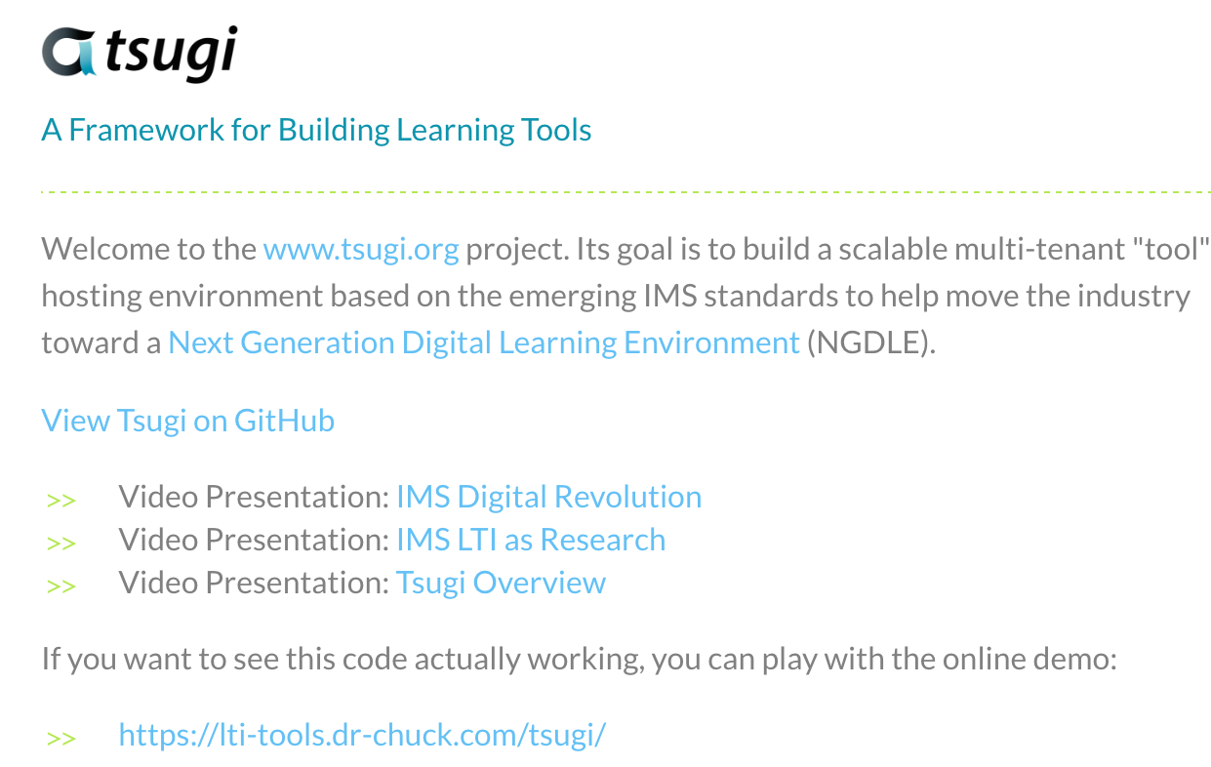
www.da-eum.org
www.tsugi.org

Slide 27
What's can Tsugi Do?
A Course-Oriented LMS / CMS at a URL
App Store for Learning Applications
Course-Oriented Content Repository
API Libraries – PHP, Java, Node...
Open source standards implementations
Training for Developers (www.wa4e.com)

Slide 28
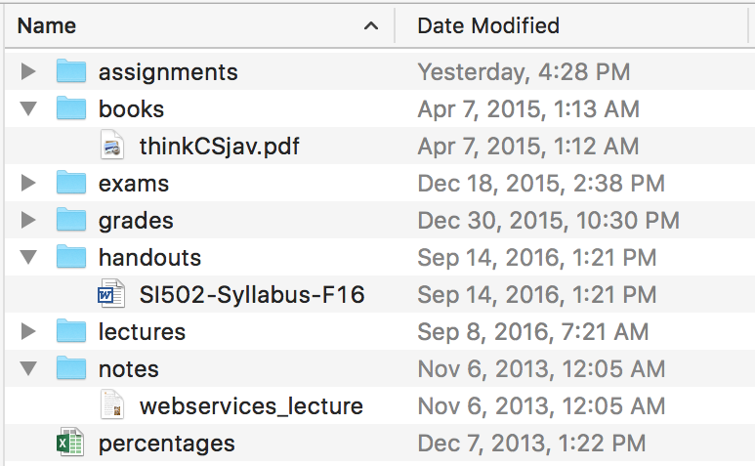
Authoring a Course
Sakai
Canvas
Moodle
Blackboard
Coursera
…

Slide 29
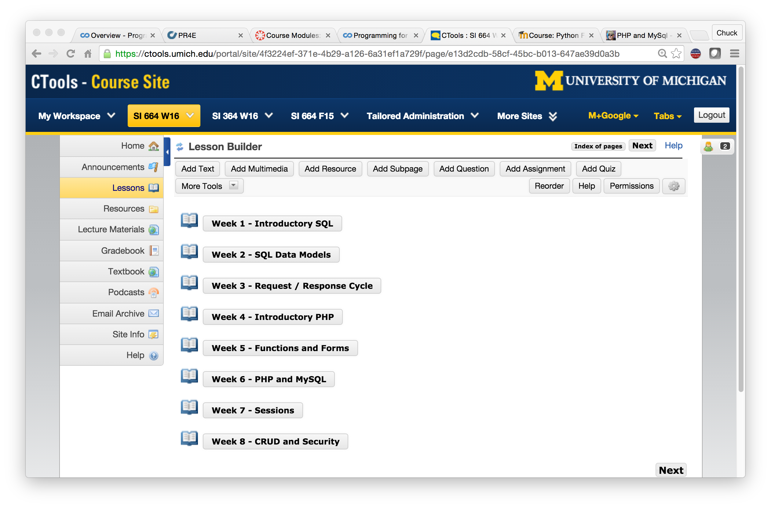

Slide 30
You Are Teaching a MOOC!
Sakai
Canvas
Moodle
Blackboard
Coursera
…

Slide 31
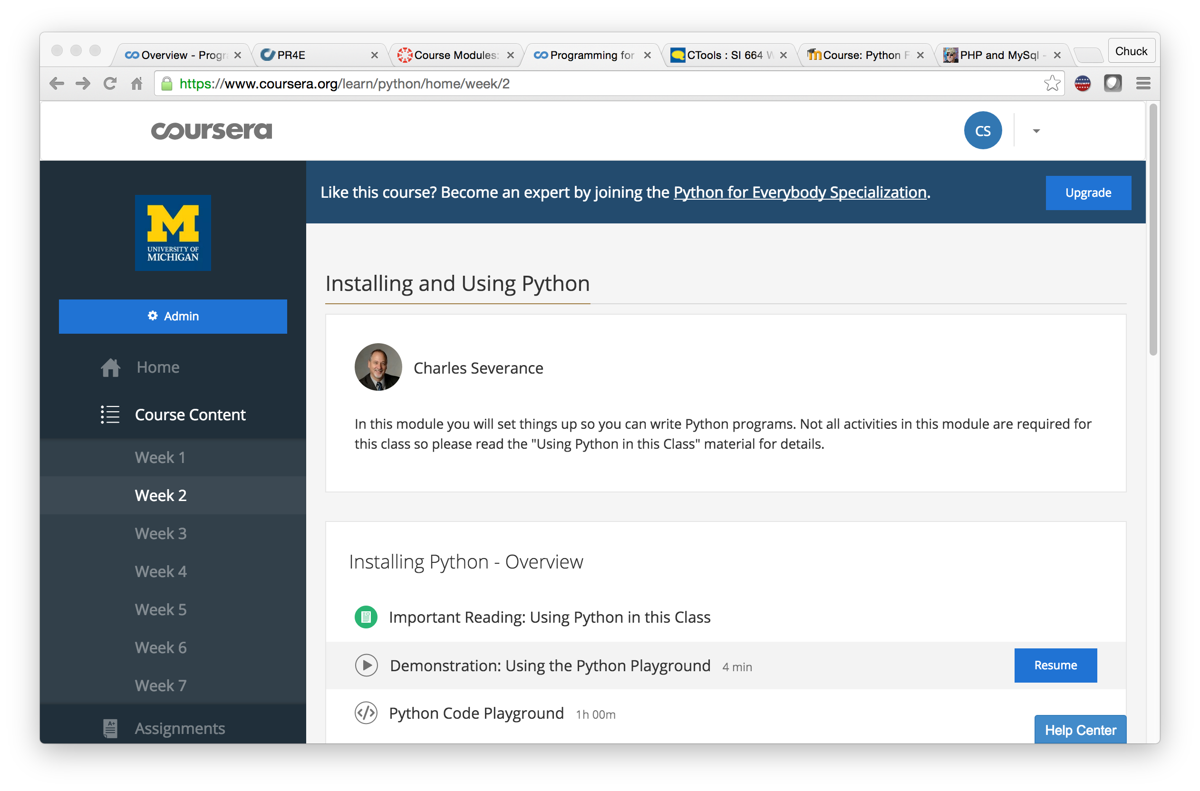

Slide 32
Surprise: New LMS This Fall!
Sakai
Canvas
Moodle
Blackboard
Coursera
…

Slide 33
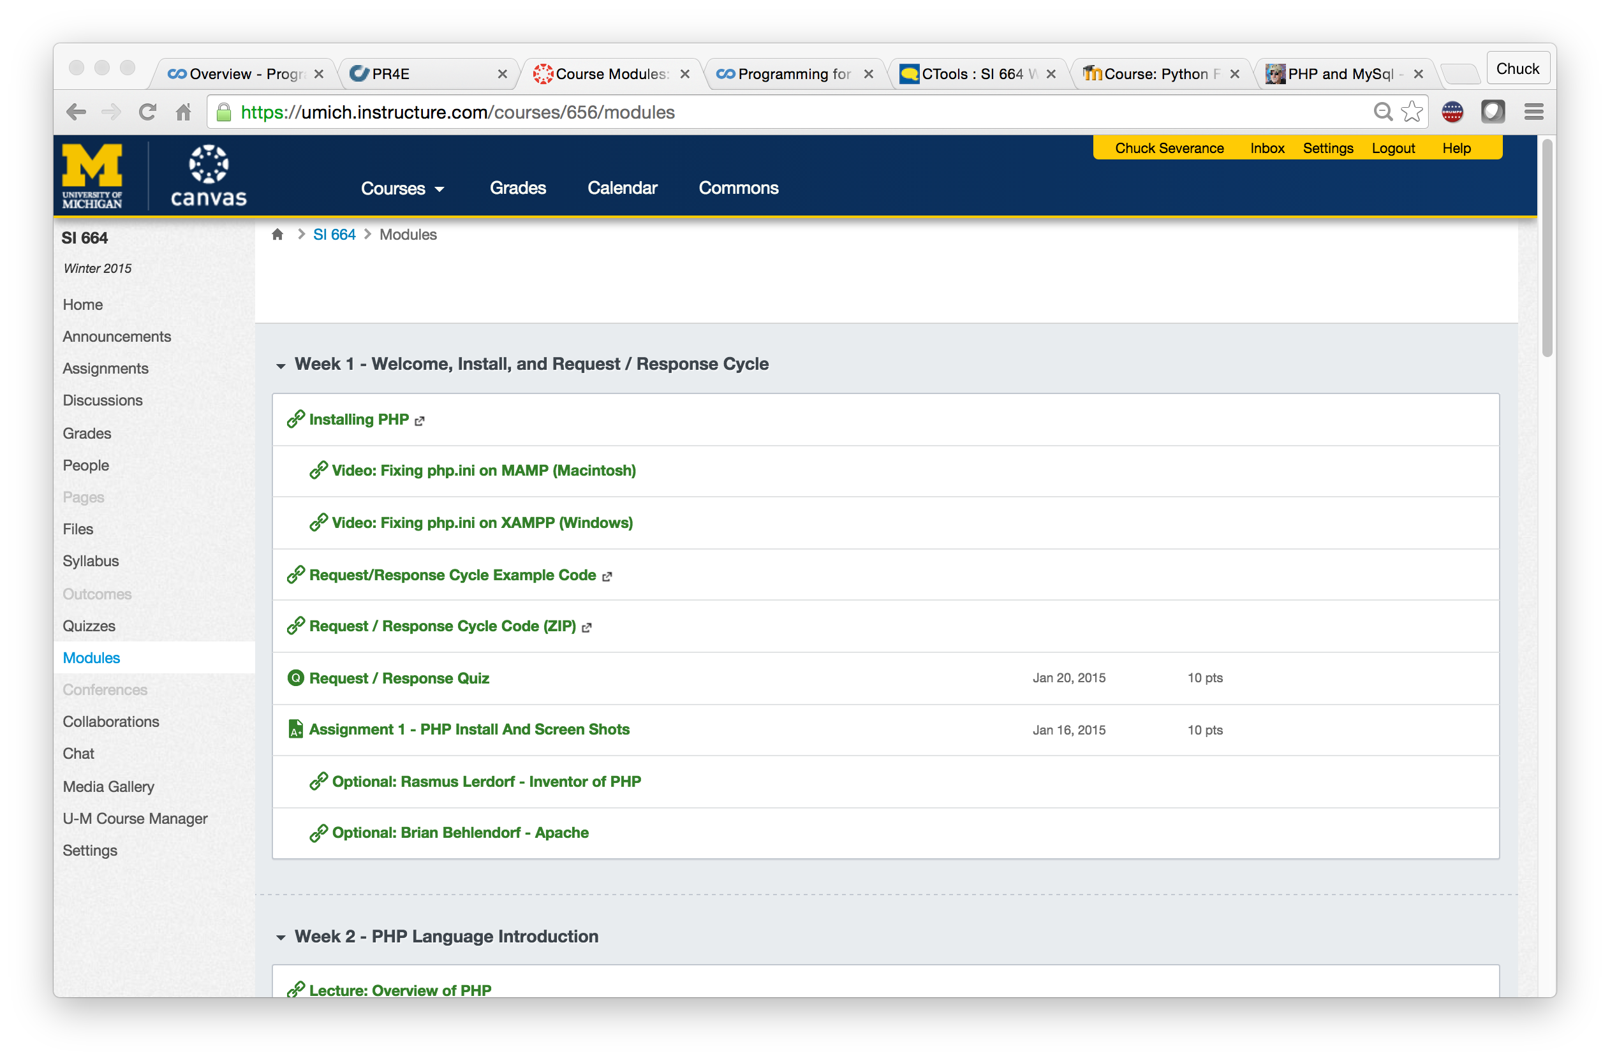

Slide 34



Sakai
Canvas
Moodle
Blackboard
IMS LTI
IMS CC
Coursera
…

Slide 35
PY4E.com

Slide 36
PY4E.com
A beautiful web site that is also an LMS and complies with interoperability standards.

Slide 37
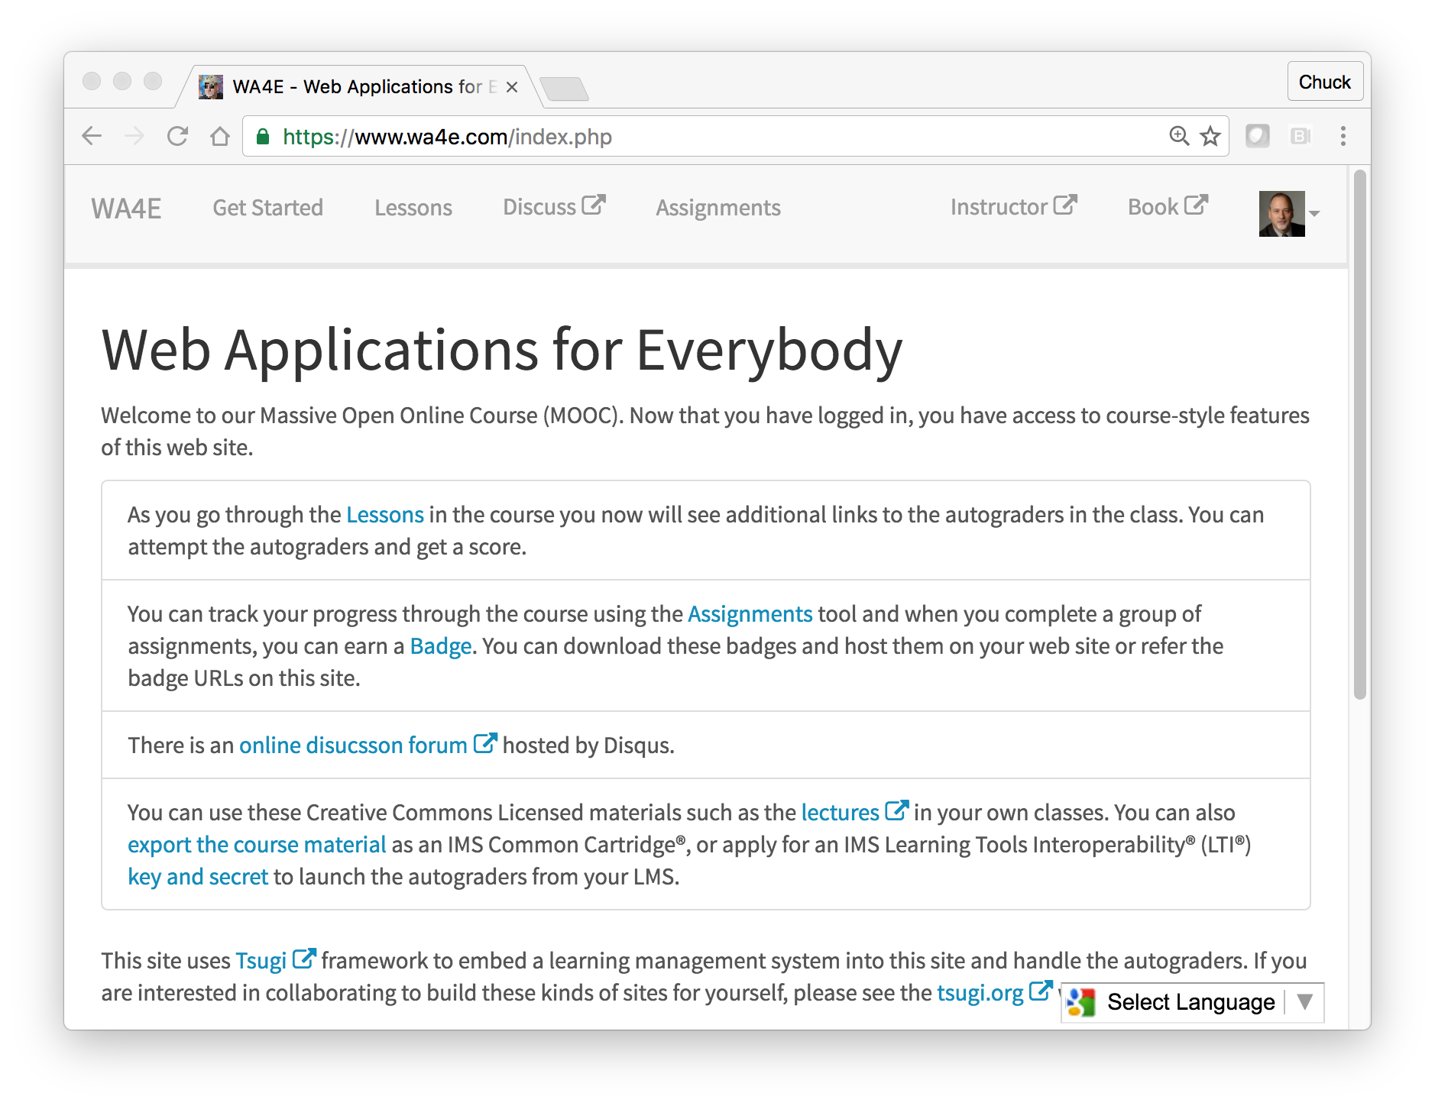
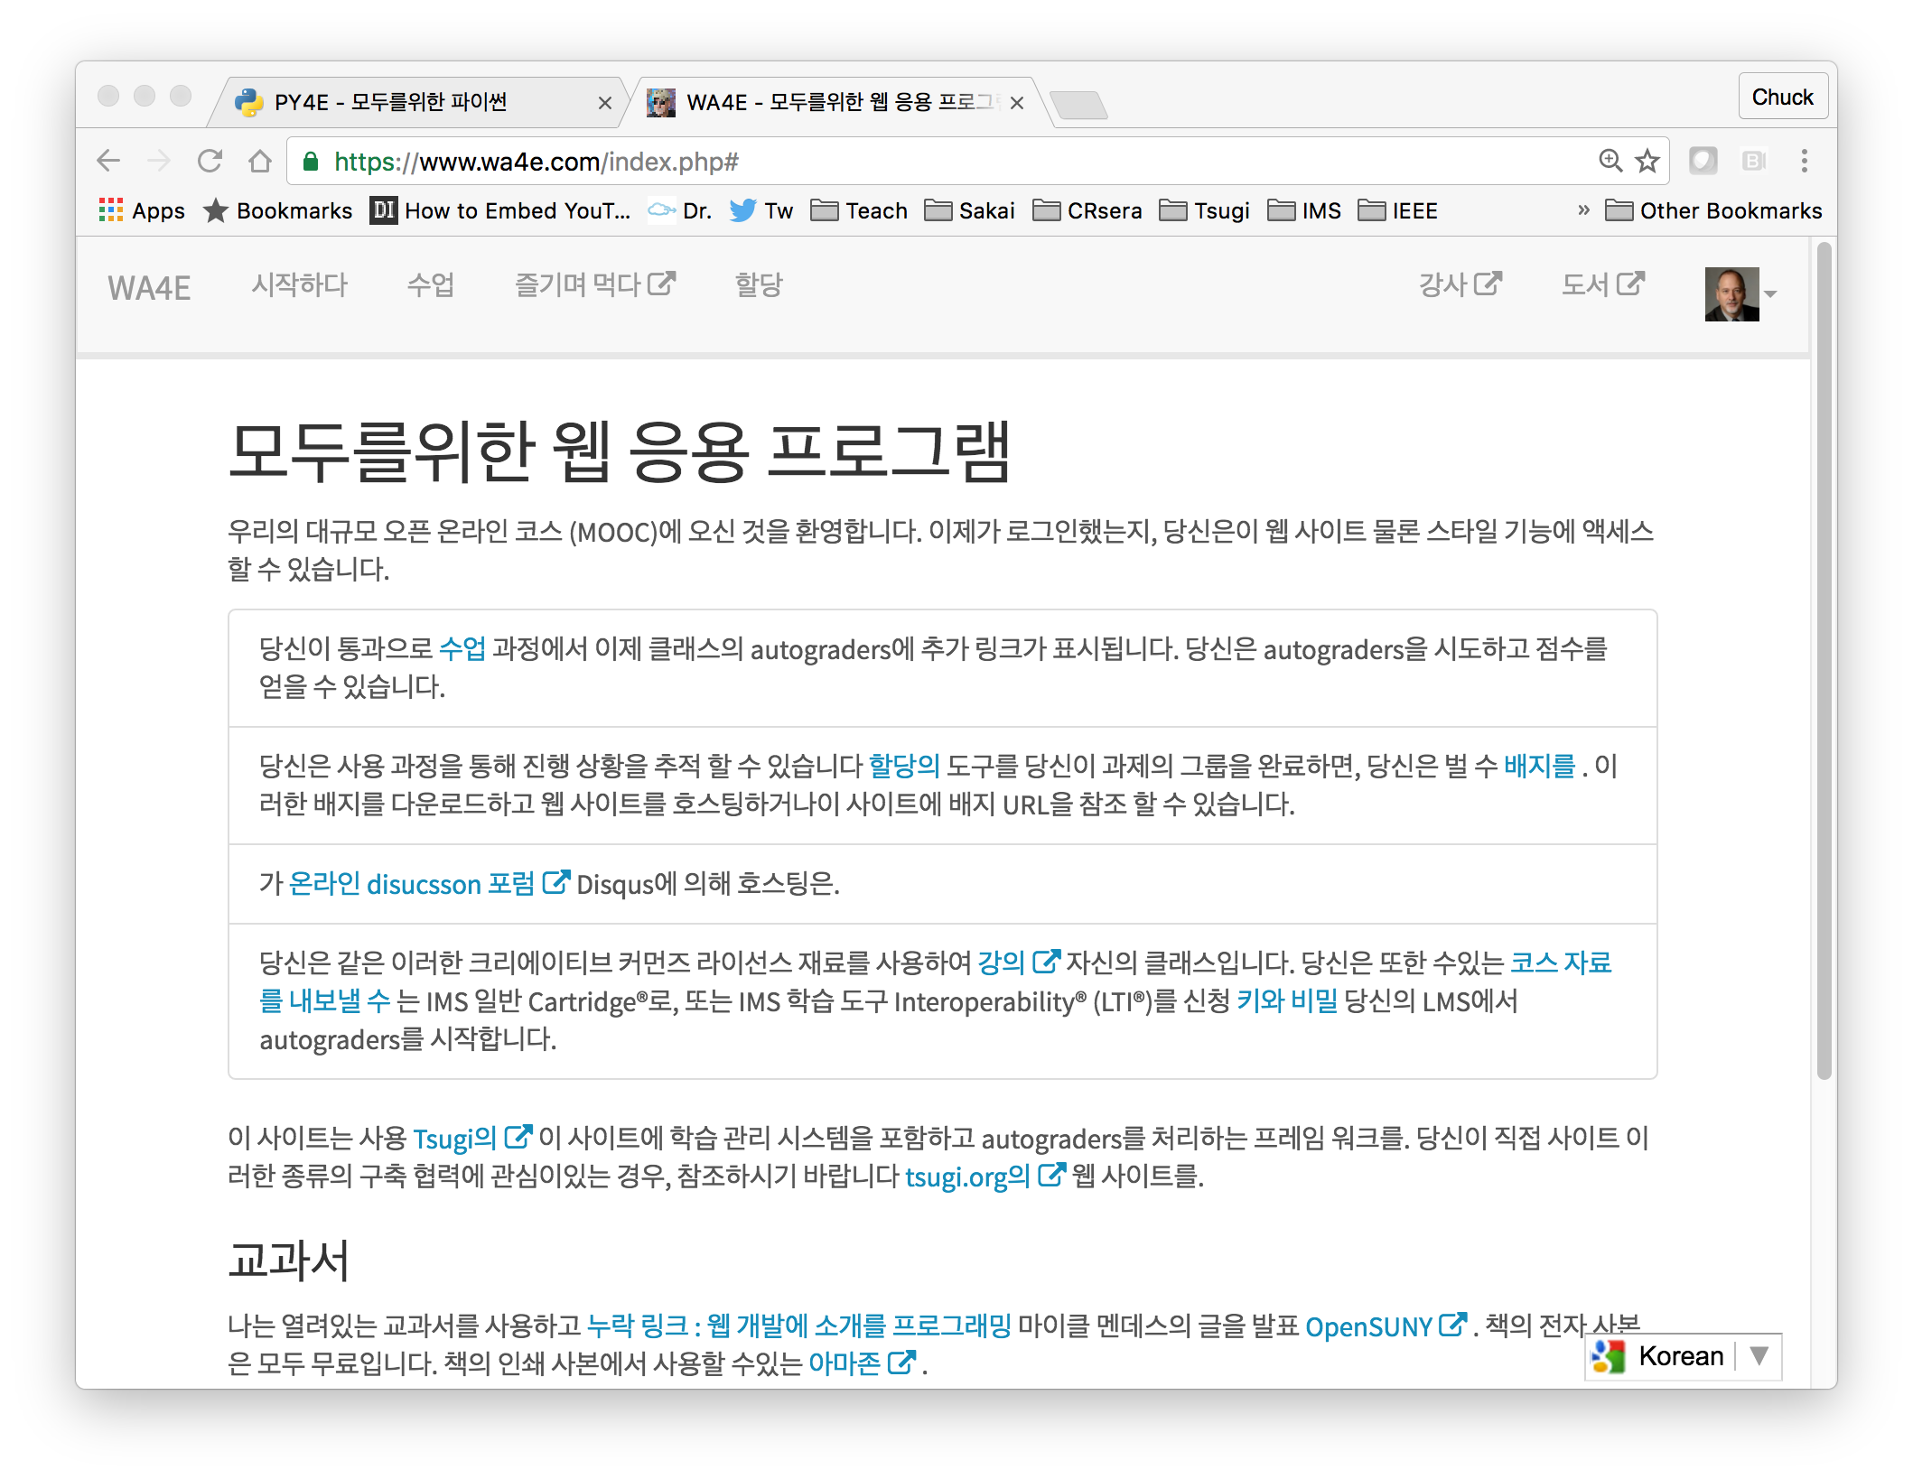
WA4E.com

Slide 38
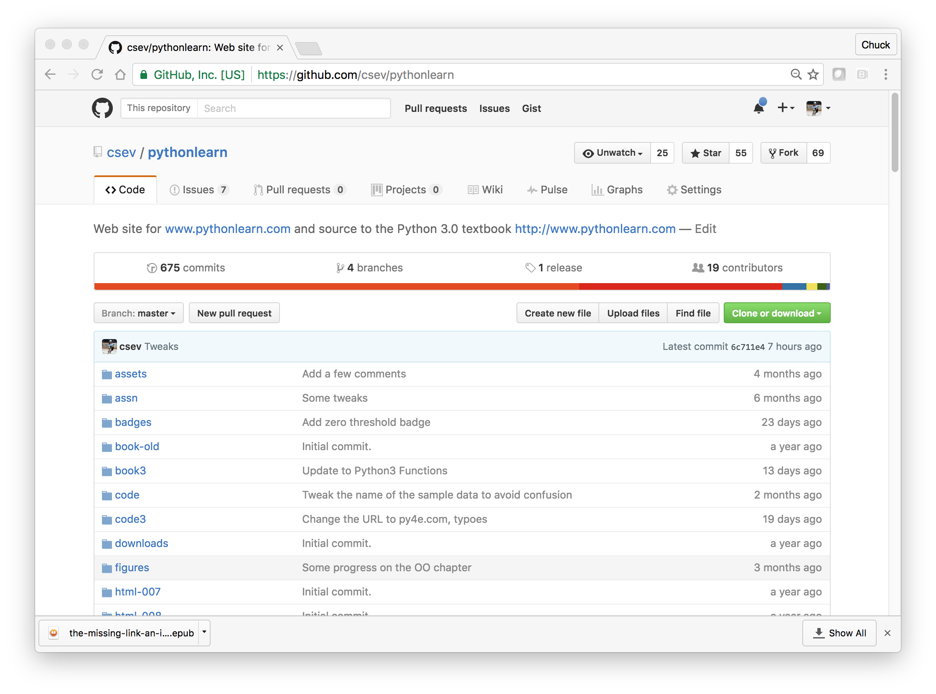
Collaborative Content w/GitHub
https://github.com/csev/pythonlearn

Slide 39
Inside Tsugi

Slide 40
Tsugi Store
Tsugi
Console
APP
Tsugi
PHP
MySQL
Database
APP
LMS/CMS
APP
Canvas
Sakai
Coursera
Tsugi
Moodle
…
APP
Tsugi
Java
APP
APP
LTI
APP
Tsugi
Node
APP
APP
Python
Test
CC
Tsugi
LOR

Slide 41
Tsugi APIs
Tsugi Module
Tsugi App
???
UI/UX APIs
Look / Feel
UI Widgets
Opinionated APIs
Convention / Database Model / Session
Easy for App Developer to Use
Utility APIs
Implement Standards
Portable / Resuable outside Tsugi

Slide 42
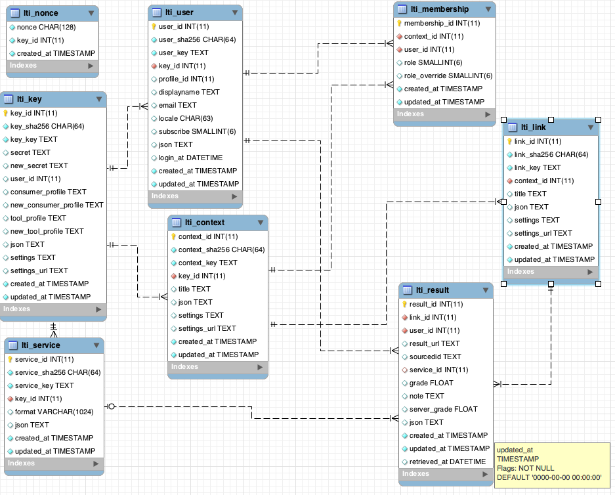
Tsugi Data Model
tsugi/docs/lectures/02-Data-Model-Workbench.mwb

Slide 43
Tsugi Developer Training
PHP / MySQL – www.php-intro.com
Tsugi Recorded Lecture Series
http://lectures.tsugi.org/
Lots of sample code
Assignments for Developer Workshop
Grade, Chat, Map, Wisdom of Crowds
https://github.com/csev/tsugi-php-exercises

Slide 44
Tsugi Production
Tsugi LMS – MOOC Of My Own
www.wa4e.com
www.py4e.com
Auto grading and peer grading for Coursera
pr4e.dr-chuck.com – 214353 user accounts
On campus Sakai/Canvas/Blackboard and demo accounts
lti-tools.dr-chuck.com
Static assets on CloudFlare CDN
https://www.dr-chuck.net/tsugi

Slide 45
Source: Ian Dolphin

